Slide 1
Neutrinos from
Primordial Black Holes
Dustin Nguyen

Slide 2
Motivation
The DM problem cannot be explained by stellar, IMBH, and SMBH populations
BHs formed in the early universe can span a wide mass range. These BHs are termed primordial.
We perform analytical and numerical calculations of these BHs, if they were the DM, in the milky way and try to constrain PBH density to CDM density using deduced flux calculations from new neutrino observatories.

Slide 3
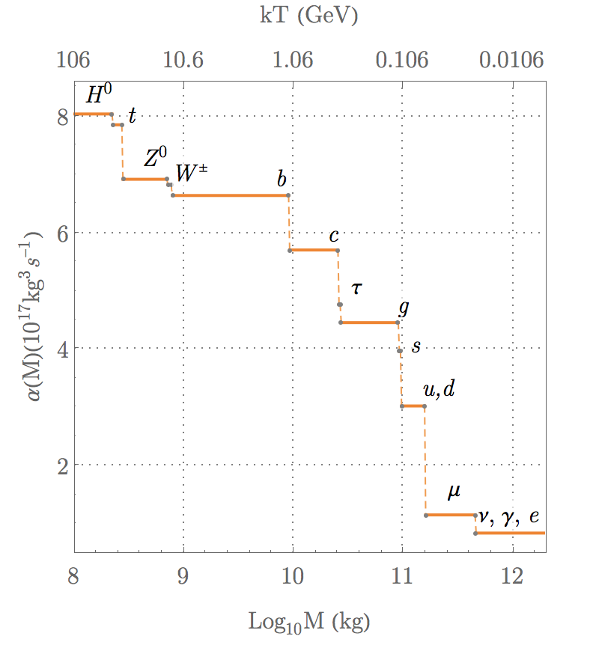
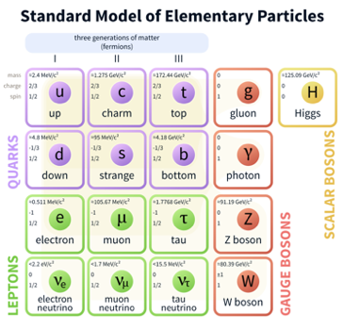
Hawking Radiation
An uncharged non-rotating BH emits particles, within energies Q+dQ, per degree of freedom, at a rate
Replicated as in (Bugaev et al 2000).

Slide 4
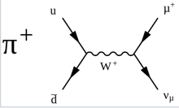
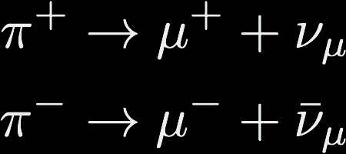
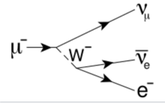
Neutrino Channels
Hadronization of quarks and gluons into mesons
Charged pion decay
Charged muon decay
Directly emitted neutrinos

Slide 5
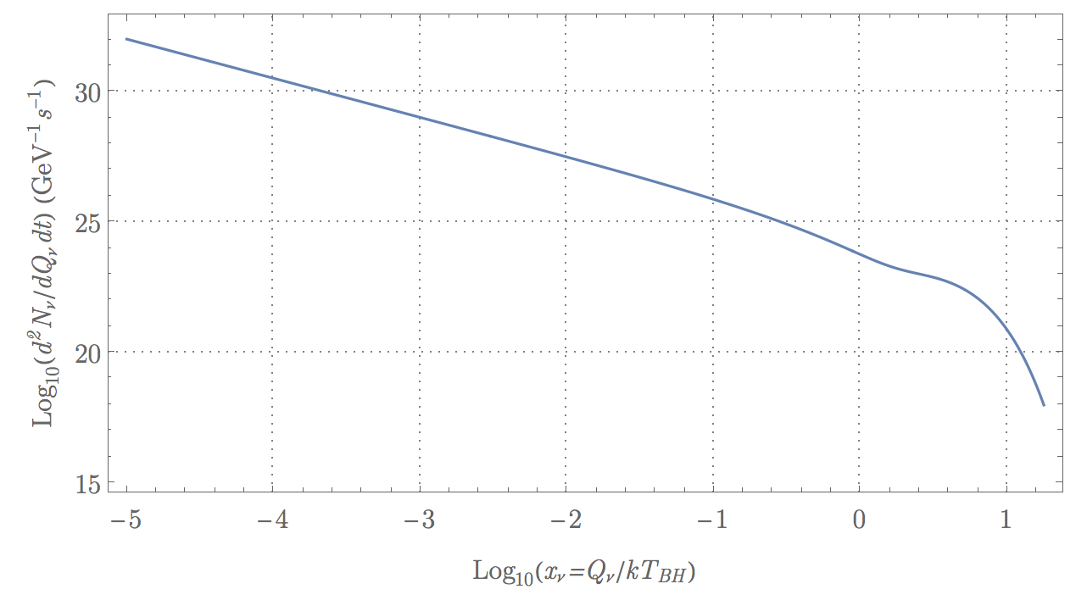

Slide 6
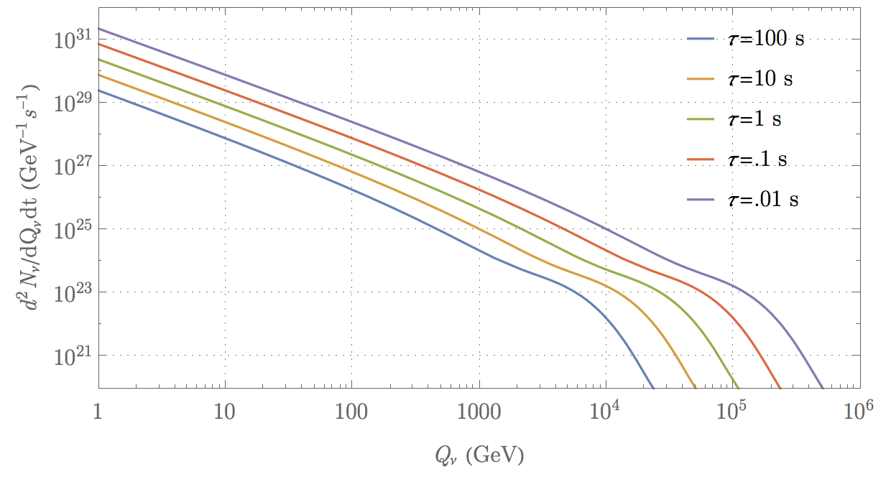
Parametrization
Recover Q/kT
Introduce time dependency

Slide 7
Application: DM in MW galaxy
We need to convolve the spectrum of an individual BH (spatially independent) with the entire BH population of the MW
  Assume
  Assume average mass function scales radially as average DM density profile:
  Our emissivity function is then

Slide 8

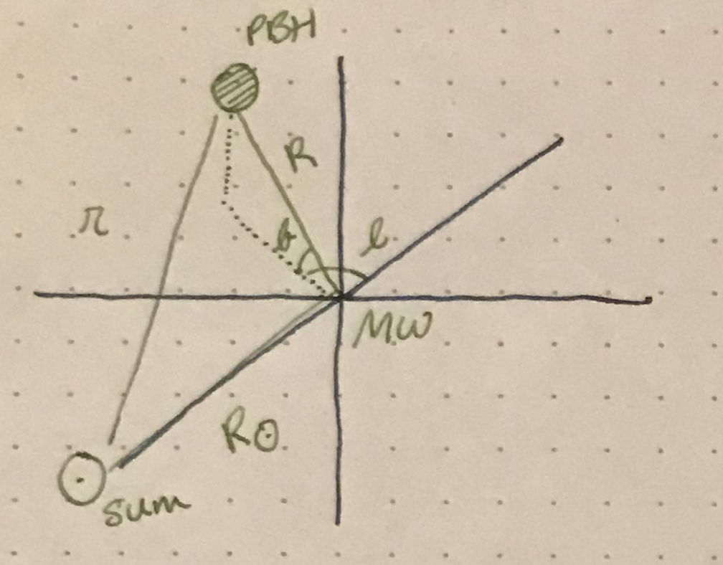


Line of Sight Integration
We’re then interested in the flux from each of these BHs a distance r away

Slide 9
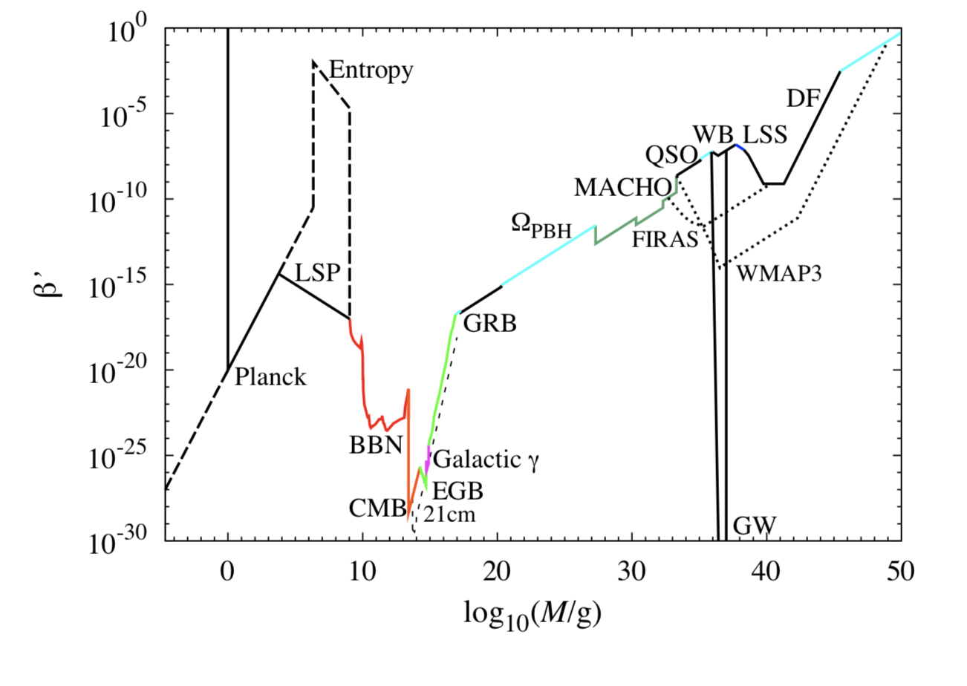
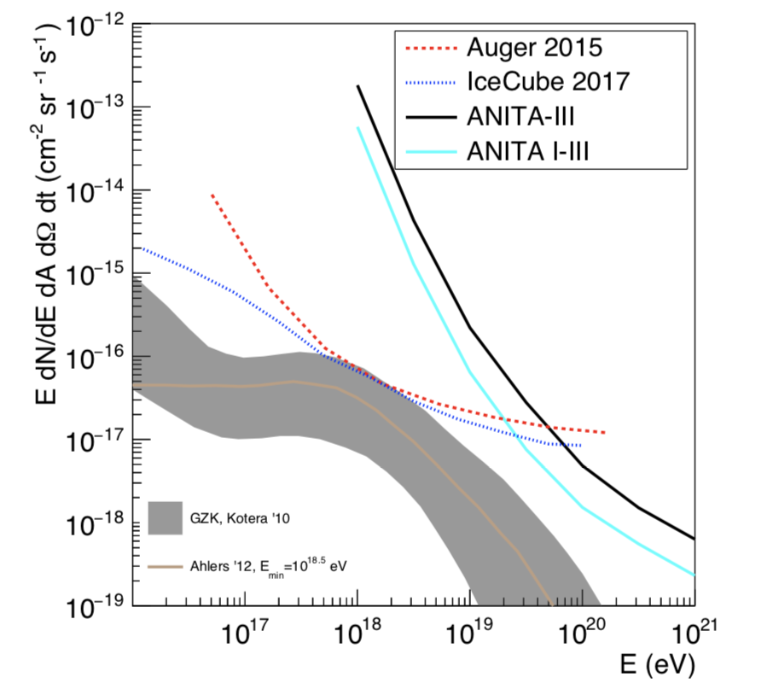
(Carr et al 2014)
(Allison et al 2018)

Slide 10
Summary
PBHs might be able to explain DM problem
We derived a parametrization for the total neutrino energy spectrum rate from an individual BH
We are working towards getting the expected flux as a function of neutrino energy, which we will then compare to known limits, which will then allow us to possibly constrain PBHs
Acknowledgements: Thanks to my advisor, Cecilia Lunardini, for guidance and NASA space grant consortium for funding this project.

